Slide 1
Countries

Slide 2
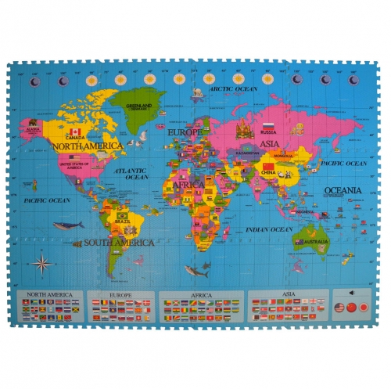
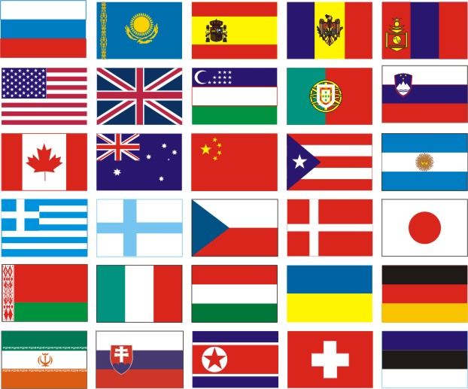

Slide 3
Our aims:
Listen, read and talk about:
Countries and nationalities
Learn how to:
- Talk about your country

Slide 4
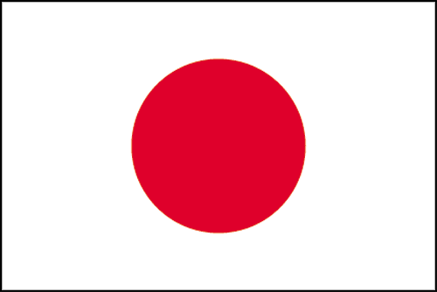
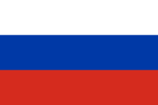
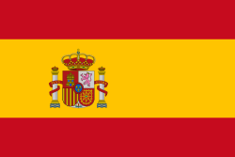
Match the countries to the nationalities:
What nationality are you?
Japanese;
German;
Russian;
Spanish;
Brazilian;
- British;
- Polish;

Slide 5
How many colours does it have?
What colour is it?
Is it the Russian flag?
- It has got … colours.
They are …
Yes, it is/No, it isn’t.

Slide 6
Everyday English
S – the south;
N – the north;
E – the east;
W – the west;
NE – in the northeast;
NW – in the northwest;
SW – in the …
SE – in the …

Slide 7
Where exactly is Punta Arenas?
It’s in the north of Chile.

Slide 8
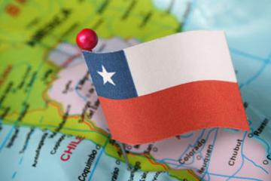
Reading I Chile
1. Where’s Maria from?
2. What’s the capital city of Chile?
3. What can a tourist see in Chile?

Slide 9
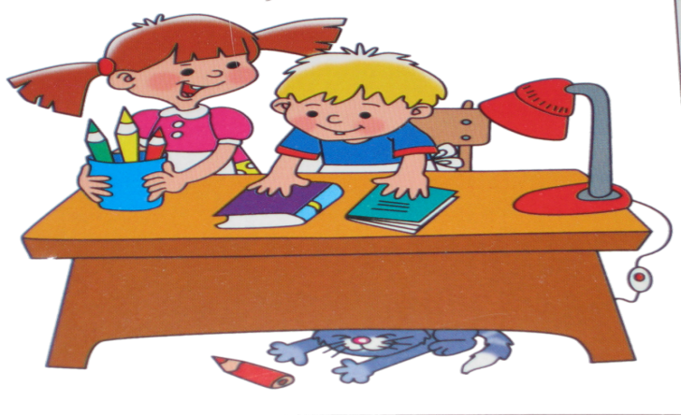
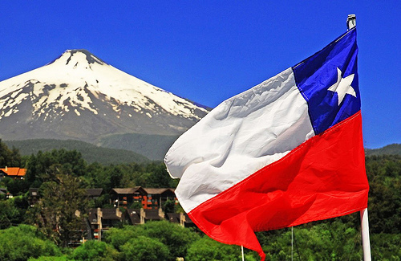
Speaking
Name 3 things you remember about Chile

Slide 10
Did you like our lesson?
Yes or No

Slide 11
Reflexion:
What did you listen, read and talk about at the lesson?
What did you learn at the lesson?
Was it difficult for you at the lesson?

Slide 12
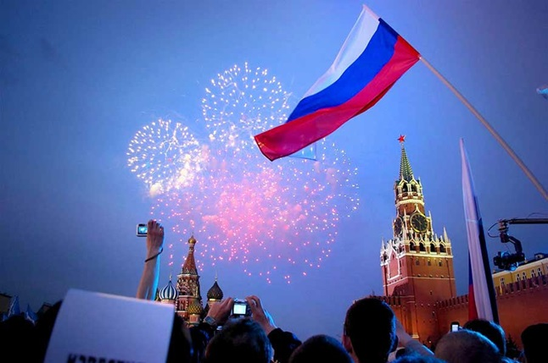
Homework
Writing
Write a short article and make a presentation about your country :
name;
location;
capital city;
places a tourist can visit;

